Slide 1

Canvas Drawing Objects and the Animation Loop
Programming Guides

Slide 2
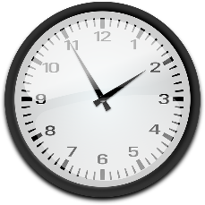

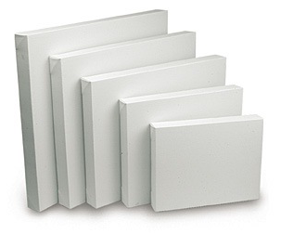
Activity 1
3 minutes
What is a Canvas?

Slide 3
Tkinter – GUI Building in Python
Introduction
Today we will look at a new widget called ‘the canvas’.
This widget is great for images, drawing objects and animations.
Will now look at how a canvas widget can be created, how drawing objects can be placed on a canvas and how we can animate these drawing objects using ‘an animation loop’.

Slide 4

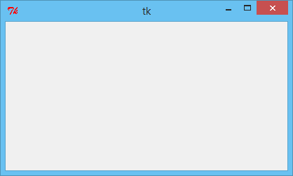
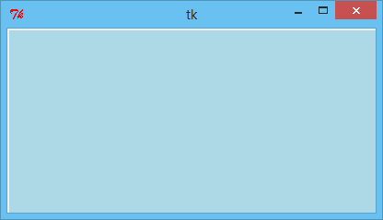
Tkinter – GUI Building in Python
Canvas Widget
The canvas widget is a ‘blank canvas’ on which we can draw, place images and print text characters, amongst other things.
To create a canvas widget we simple add the following code and assign it to a variable, which will hold this widget (in this example it is ‘canvas1’):
We then use the grid method to locate the widget in our window object.
At this point your window will look no different. But, a canvas widget has been added.
To prove this we could change the background colour of the widget by adding the property (bg=”light blue”).

Slide 5

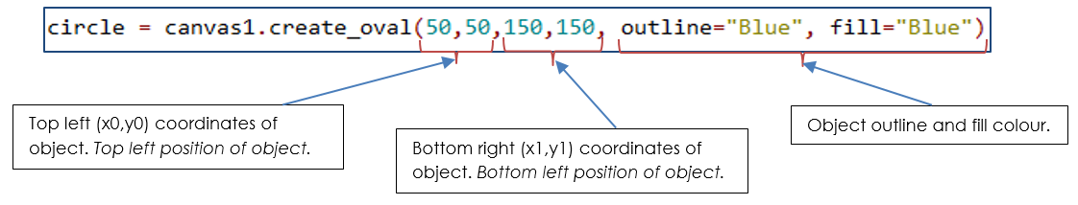
Tkinter – GUI Building in Python
Drawing Objects
Now we are in a position to start adding drawing objects onto our canvas.
To add a circle to our canvas, we simply need to add the following code:
This code creates an oval inside the canvas widget and then assigns this drawing object to a variable (in this case ‘circle’). When creating the oval, the following properties are needed:

Slide 6
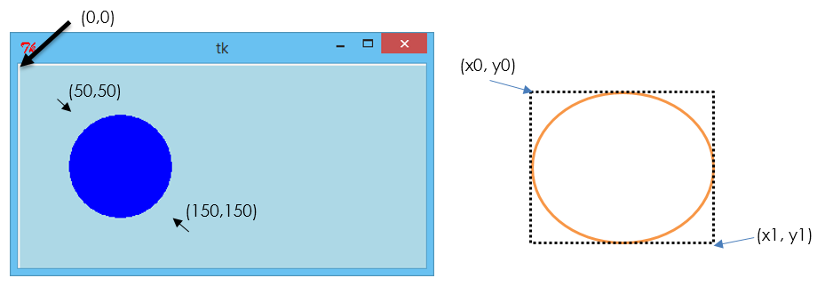
Tkinter – GUI Building in Python
Canvas Positioning
The image below shows the circle now drawn on the canvas widget.
The diagram to its right demonstrates the coordinates system for positioning the oval.

Slide 7
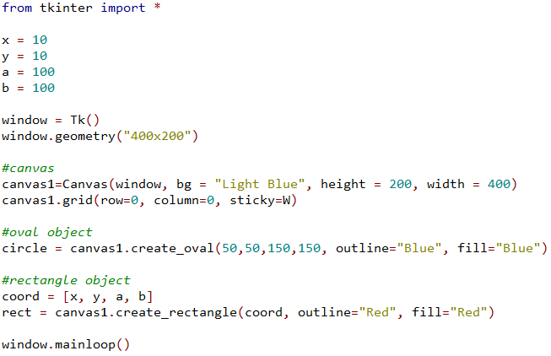
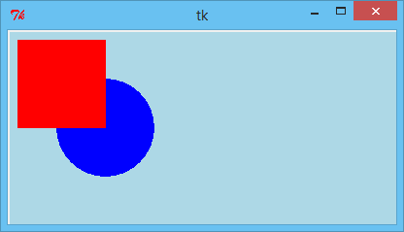
Tkinter – GUI Building in Python
Canvas Positioning – Using Variables
In this example you can see how variables x, y, a and b have been created and then added to a list. This list is then used in the create_rectangle code to positon the rectangle.
If we eventually want the drawing object to move (whether it be animated or moved when a key is pressed), adding coordinates in this way is good practice. A quick change of the x, y, a, b variables can effectively update the drawing without having to access the create_rectangle code itself.

Slide 8
Tkinter – GUI Building in Python
The Animation Loop
An animation loop function is one which can be implemented to move canvas items and update the coordinates of the item repeatedly or repeatedly whilst certain conditions occur.
To understand how an animation loop works we need to understand 3 methods.
2 of which are applied to the canvas widget.
1 of which is applied to the window object.

Slide 9
Tkinter – GUI Building in Python
canvas_widget.move(canvas_item, x, y)
The code above is used to move a canvas drawing object.
We add the canvas object name to the brackets (parentheses).
We then add the size of the ‘x jump’ (distance along the x axis the object is to move).
Then the size of the ‘y jump’ (distance along the y axis the object is to move).
0
1
2
3
4
5
6
7
8
0
1
canvas.move(circle, 2, 1)
The code above would move the circle 2 along the x axis and 1 along the y axis.
This jump would happen ever time the code is run.
2
3
4

Slide 10
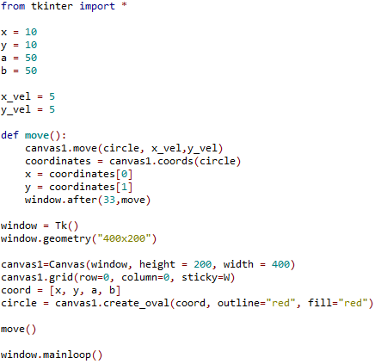
Tkinter – GUI Building in Python
canvas_widget.coords(canvas_item)
The code above is used to ‘get’ the coordinates of the canvas item.
This code is usually assigned to a tuple which will contain all 4 coordinate values (x0,y0,x1,y1).
e.g.:
0
1
2
3
4
5
6
7
8
0
1
(3,2)
When the code above is run, coordinates will be assigned the values: (3,2,6,4).
These are the coordinates of the drawing object at that time.
2
3
(6,4)
4

Slide 11
Tkinter – GUI Building in Python
window_object.after(milliseconds, function_name)
The code above is used to call a function after a given value of milliseconds.
In other words “after the window has been displayed for ‘t’ milliseconds, call function ‘function_name’”.
Wait
33
milliseconds
Wait
33
milliseconds
Run function code
Run function code
Run function code

Slide 12
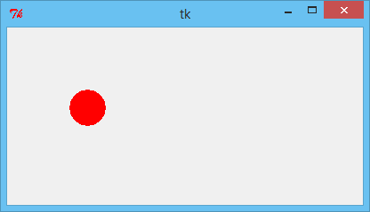
Tkinter – GUI Building in Python
In this code you can see that 2 new variables have been created: “x_vel” and “y_vel”.
These values are the size of jump we want the drawing object to move along the x and y axis each time we run a function.
We then create a function called move(). This function moves the drawing object using x_vel and y_vel as the distance to move the object ‘each jump’. We then establish the new coordinates of the object and assign these values to a tuple called “coordinates”. Then we assign ‘x’ and ‘y’ with the new ‘x’ and ‘y’ coordinates of the object so that their position is updated. Then finally we wait 33 milliseconds and then call the same function again. So in effect, the function is calling itself (which is known as ‘recursion’). But, strictly speaking, this function is not a ‘recursive’ function.
Why is this animation loop not recursive? – because it does call itself, doesn’t it?
When a function calls itself, it is known as ‘recursion’, but this function calls itself after 33 milliseconds, which means that the function has time to finish before calling itself again. If it didn’t, as each function calls itself, it would add itself to a stack and if this function continued to call itself indefinitely it would use up the computer’s resources and crash – good job it isn’t recursive really!

Slide 13
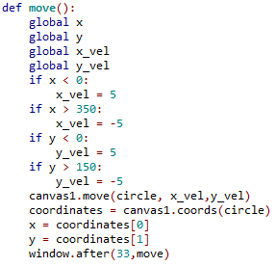
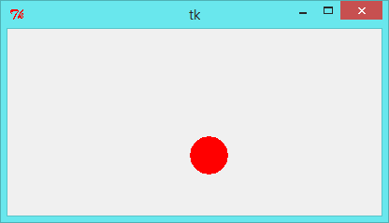
Tkinter – GUI Building in Python
Making the Ball Bounce
The code on the previous slide animates the circle, but very soon after the circle moves off the screen, never to be seen again.
With a small change (notable the addition of some IF-Statements), it is possible to get the circle to appear to bounce off the walls of the canvas.
Here is an example of how the animation loop (move() function) can be updated to enable the ball to appear to bounce off the walls of the canvas.
Firstly, because we will need to access the values of x, y, x_vel and y_vel, we need to ‘load’ these global variables into the function. We do this by adding the word ‘global’ before the variable name.
Then all we do is we add a simple set of IF-Statements:
If the ball’s x position is less than 0, we make the ‘x-jump’ positive, sending the ball right.
If the ball’s x position is greater than 350, we make the ‘x-jump’ negative, sending the ball left.
If the ball’s y position is less than 0, we make the y-jump’ positive, sending the ball downwards.
If the ball’s y position is greater than 150, we make the ‘y-jump’ negative, sending the ball upwards.

Slide 14
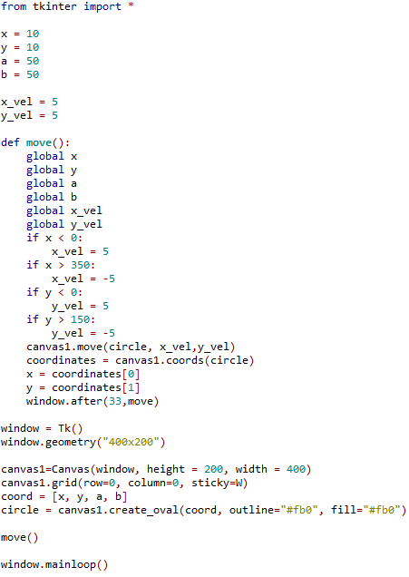
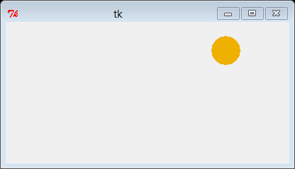
Here is the code in full to get a ball bouncing around a canvas widget.

Slide 15
Activity 2
30 minutes
Use this presentation to create your own bouncing ball
Adapt the code so that the ball moves faster
Adapt the code so that the a second drawing object is added to the canvas.
Adapt the code so that this second drawing object is animated so it also bounces around the canvas
Adapt the code so that this second ball bounces in a smaller area of the screen

