Slide 1

Introduction to Object Oriented Programming
Programming Guides

Slide 2
Object Oriented Programming
Introduction
So far we have looked at Python as a ‘procedural programming language’. Procedures (or functions) are executed on the data and variables to perform a task. These functions can be called anywhere in the main program, and by other functions as well.
Python can also be regarded as an ‘object orientated programming language’. This is because as well as having functions to act on the data, the language also enables the creation of something called ‘classes’, from which ‘objects’ can be made.
Object Orientated Programming (OOP) is nothing to get worried about. It isn’t any more ‘scary’ than what we are used to, it is merely a ‘DIFFERENT WAY OF THINKING!’

Slide 3
Object Oriented Programming
The limitations of programing the ‘procedural’ way
If we were planning to create a racing game involving 50 different cars on a track, we may think of creating each car using a series of different variables to hold different pieces of data about each car.
We may also create several different functions to act on the data in these variables, such as a function to simulate acceleration, so that different cars’ speeds increase at different times.
As we create more cars, we will not only end up having a great deal of variables, which will be difficult to keep track of, we will also end up duplicating very similar data time and time again.
This is not efficient, and programmers like to be efficient!

Slide 4
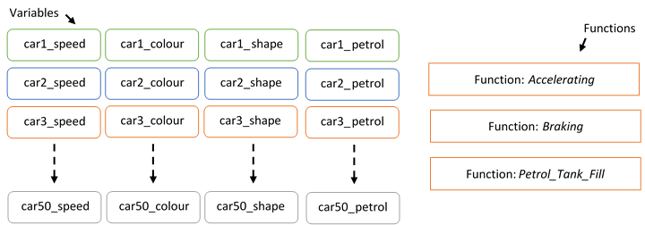
Object Oriented Programming
A ‘procedural way of thinking’ about creating a car racing game:
Lots of variables and the whole structure of the program is a bit disjointed.

Slide 5
Object Oriented Programming
The benefits of programming the ‘object orientated’ way
An object orientated approach looks at this same problem in a very different way.
Instead of individually creating each car by producing a load of variables to hold data about the car and then creating loads more similar variables for the next car, and so on and so forth, the ‘object orientated’ approach looks to create a blueprint (or template) for ‘a car’, and then uses this blueprint to make ‘car objects’.
This way we are only ‘defining’ the car once, and then quickly using this definition to build as many car objects as we wish.
This means that there is no unnecessary duplication of variables, therefore improving efficiency, as well as the improved ability to keep track of each car and its data.

Slide 6
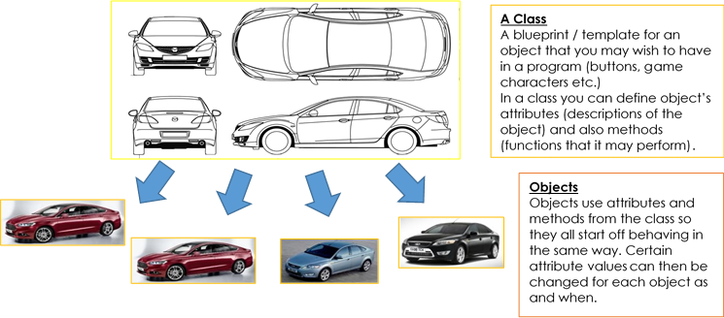
Object Oriented Programming
An ‘Object Orientated way of thinking’ about creating a car racing game:

Slide 7
Object Oriented Programming
Classes and Objects
In Object Orientated Programming (OOP), the blueprint is known as a CLASS. You can think of a class as a factory for creating objects.
Classes
If we think about an object (any object) in the real world (for example a ball), there are really only 3 things we need to describe it:
  Its name (e.g. ball)
  What it is like (e.g. it is round, it is green, it is 30cm high etc)
  What it does (e.g. it can move, it can deflate, it can spin etc)
Because of this, a class (or an object blueprint) is made up of three sections and these three sections are used to describe the object(s) which will be created from the class.
  Class Name
  Attributes (essential features / characteristics of the future object)
  Methods (things that the future object can do or that we want the future object to do)

Slide 8


Object Oriented Programming
The Human Example
If we wanted to create a game which had human characters or an ordering system with ‘human’ users, we may wish to create a human ‘class’, from which we can create lots of human ‘objects’.
To do this we would need to design our class.
We could give the class a name.
We could then give the class attributes (characteristics of a human) such as name, age, nationality and gender.
We could also give the class methods (things that humans do) such as speaking, eating, telling a joke.
Class Name:
Human
Attributes:
Name
Age
Nationality
Gender
Methods:
Speak
Eat
Tell a Joke

Slide 9
Questions – OOP Theory
What is the Object Orientated paradigm of Programming?
What is a Class?
What 3 things are needed to define a class?
What is created from a class?
What is an attribute?
What is a method?
Define a new class called “Monster” using a UML diagram

Slide 10


Object Oriented Programming
The Human Example
To create a ‘Human Class’ would need to first design our class.
We give the class a name.
We then give the class attributes (characteristics of a human) such as name, age, nationality and gender.
We also give the class methods (things that humans do) such as speaking, eating, telling a joke.
Class Name:
Human
Attributes:
Name
Age
Nationality
Gender
Methods:
Speak
Eat
Tell a Joke

Slide 11

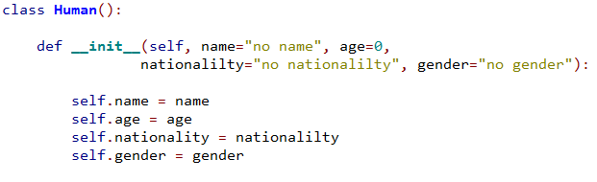
Object Oriented Programming
Programming a Class in Python
So, we have planned out our class. But how do we actually write one in the Python programming language?
We begin defining our class by giving it a name.
Next, indented underneath, we define our class attributes.
Class Constructor
Constructs the attributes of our class.

Slide 12
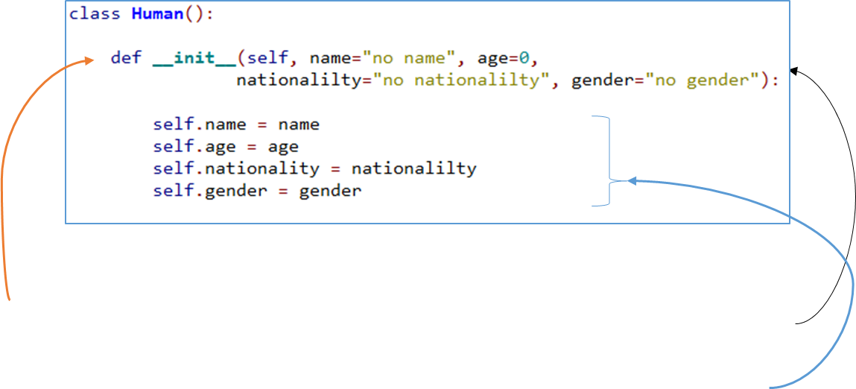
Object Oriented Programming
Attributes
What is going on here?
Firstly, the defining of the class attributes all occur inside a special method called a constructor.
We create our constructor method by typing def __init__().
Then, inside the brackets we write down ‘self’ followed by the starting values of any attributes (variables) that the class is to have.
Finally we create our attributes (starting self.) and assign each of the variables (created in the brackets) to each of them.

Slide 13
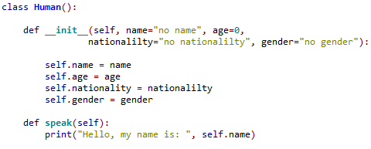
Object Oriented Programming
Methods
Next, we define our class’ methods.
Methods (which are essentially functions) define what an object can actually do. So when defining our human class (blueprint) we can also define how our objects will act on any data it is given.
In the example given above we have described three different actions that a human might perform: ‘speak’, ‘eat’ and ‘tell a joke’.
To add the speak method we add the following code to our class:

Slide 14
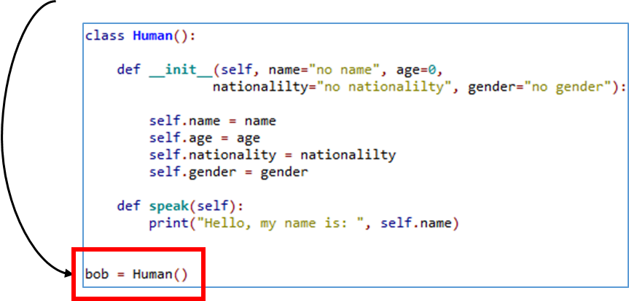
Object Oriented Programming
Instantiation (creating objects)
The creation of objects is called ‘instantiation’. When creating an object we create an instance of the class.
To create a human object from our human class we write the following code in the main section of our program:
Here, we have created a human object which has the attributes ‘name’, ‘age’, ‘nationality’ and ‘gender’ and can also ‘speak’.

Slide 15
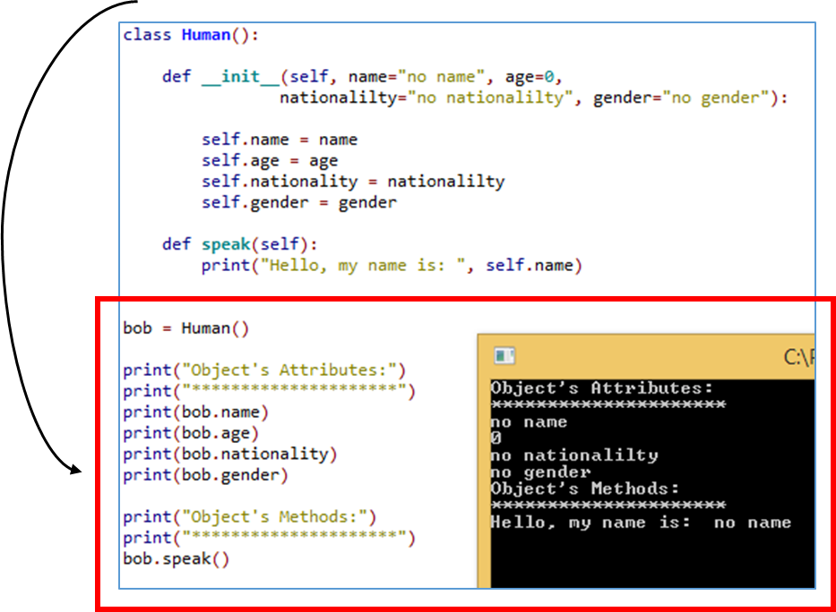
Object Oriented Programming
Instantiation (creating objects)
Now that the human object ‘bob’ is created, we can get data from ‘bob’ and get ‘bob to speak’.
Here, we are accessing the objects attribute values and methods.

Slide 16
Object Oriented Programming
What is self?!
Self is incredibly important and the purpose of writing ‘self’ inside classes, will become clearer as we gain practice working with objects.
But, in essence, by prefixing class attributes with “self.”, each individual object that is created from that class can keep hold of the value of its own attributes over time.
Self is there so that an object can refer to its own data.

Slide 17
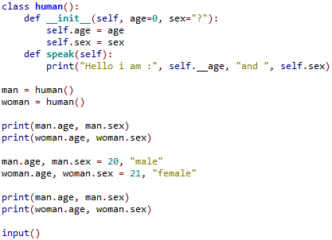
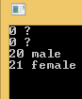
Object Oriented Programming
What is self?!
Self is a reference to the bound object:
When each object is created, the object itself is passed into the class’s parameter called ‘self’.
Now, there is a reference to the bound object.
So, whenever the object updates it’s attribute values, python can keep track of them.

Slide 18


Object Oriented Programming
Accessing objects attribute data:
To access an object’s data, we simply write the name of the object followed by…
.attribute_name

Slide 19

Object Oriented Programming
Accessing objects methods:
To access an objects method, we simply write the name of the object followed by…
.method_name()

Slide 20
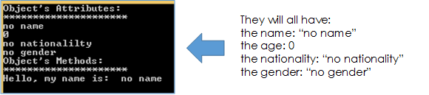
Object Oriented Programming
Instantiation & with unique/new data (passing parameters into the constructor)
Because we set up the constructor method of our class to pass values into the newly created attributes…
…all objects created…
…will all have the same attribute values.
That is, unless, we pass new values into the constructor at the moment of instantiation.

Slide 21


Tasks
Create a class called ‘Animal’
The class is to have the following attributes:
  animal_species
  age
  threat_level
  hunger_level
  And these are to be set to the following values (“unknown”, 0, “peaceful”, 0)
The class is to have the following methods:
  setSpecies() #takes a species name and sets this as animal_species
  setAge() #takes an age and sets this as age
  setHunger_level() #takes a hunger level (1-10) and sets this as hunger_level
  changeThreat_level() #takes in hunger level, updates threat_level according to the following: if hunger 0-3 (peaceful), if hunger 4-7 (narky), if hunger 8-10 (aggressive) then returns threat_level.
Insatiate an object (called Cat) from the ‘Animal’ class
Call the objects setSpecies method and input ‘Cat’
Call the objects setAge method and input 5
Call the setHunger_level method and type in 7
Call the changeThreat_level method and see if it returns the correct threat_level (should now be ‘narky’).
45 minutes

