Slide 1

Functions & Parameter Passing
Programming Guides

Slide 2
Functions & Parameter Passing
Introduction to Parameter Passing
(passing values into procedures)
As we have already seen, we can use procedures to better organise our code so that finding errors and editing the code can become easier
This is because major sections of our code is self-contained and separate from one another
One problem with the way we have previously written procedures is that the data inside it stays inside it.

Slide 3
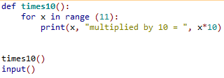
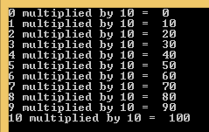
Functions & Parameter Passing
So, if I wanted to write a program which printed the 10 times table I might write a procedure like this:
Q. What if I wanted this program to allow the user to select a times table of their choice?
Using our current knowledge, I would have to create a procedure for each times table and then ask the user to select their choice.

Slide 4
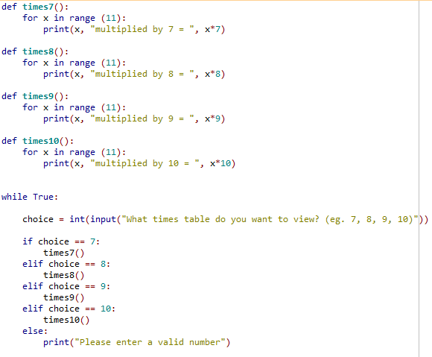
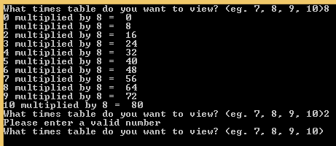
Functions & Parameter Passing
Here, you can see that the use of procedures written in this way has a drawback.
Although it is great that our code is self-contained, the issue is that the code is being duplicated (with only minor changes)
Programmers like efficiency, and duplicating code is not efficient!

Slide 5
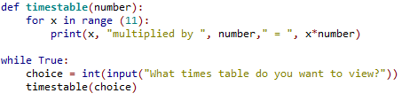
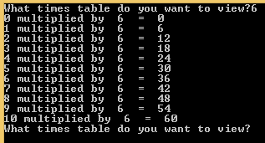
Functions & Parameter Passing
In order to be more efficient (less code) what we really want is to have one procedure to do the multiplication and PASS the users times table choice into the procedure.
This procedure here how takes on the value passed to it from the main program.
A value is being passed into it for processing.
This value is known as a parameter and this process is called parameter passing

Slide 6
Functions & Parameter Passing
The value in choice is being passed into a variable/parameter called number in the timestable function.
Important to realise that the variable name of the value being passed doesn’t have to match the destination variable name.

Slide 7
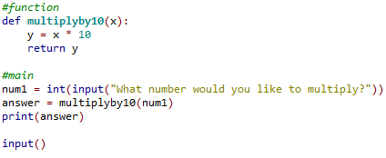

Functions & Parameter Passing
Introduction to Functions
The previous example showed how data can be passed into a procedure.
A function is a procedure that can also return data back into the main program. This can be highly useful in programming.
The way to do this is to assign a variable to the function call so that the variable is assigned any value that the function returns.
variable_name = function_name(parameter)

Slide 8
Functions & Parameter Passing
Example of parameter passing and returning values:
Passing a parameter
Returning a value
Here the arrows show how data is being passed from the main program into the functions parameter ‘x’. Num1 (here) is as a parameter and contains an argument (an item of data) which is passed to the functions parameter (x).
When the function is finished executing its commands it returns the value back into the main program. The value is returned into the variable that the function call is assigned to (in this case it is ‘answer’).

Slide 9
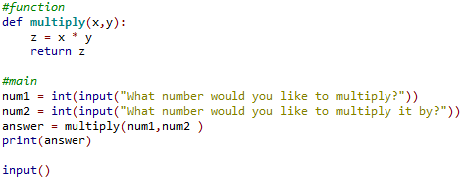
Functions & Parameter Passing
Passing and Returning more than one value (argument)
Here the arrows show how 2 parameters (each containing arguments) are being passed from the main program into the functions parameter ‘x’ and ‘y’.
It is important to realise that the names of the parameters passing the values and the parameter names of the function do not have to match. However, the order in which they are sent is the order in which they are received (num1 is sent to x, num2 is sent to y)

Slide 10
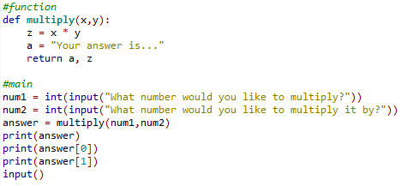
Functions & Parameter Passing
Passing and Returning more than one value (argument)
Here, the arrow highlighting the ‘return’ is showing how 2 pieces of data can be returned into the main program. Of course many more could be returned in one go in this same manner.
As these values are being returned to one variable ‘answer’, the variable automatically becomes a tuple, which is a data type that can hold a number of different values (like a ‘list’, but tuples are not editable (immutable))

